Slide 1
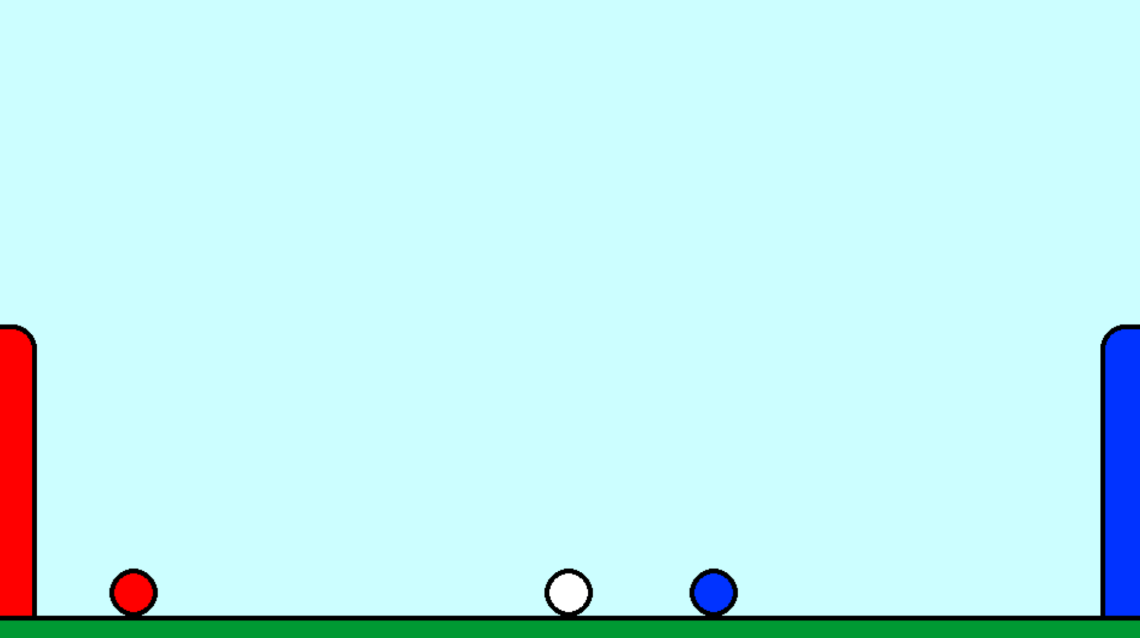
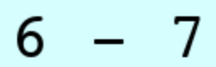
SOCCER
920
Self-Optimizing Competitive Control via Efficient Reinforcement
Cheuk Hei Chu Atul Shatavart Nadig

Slide 2
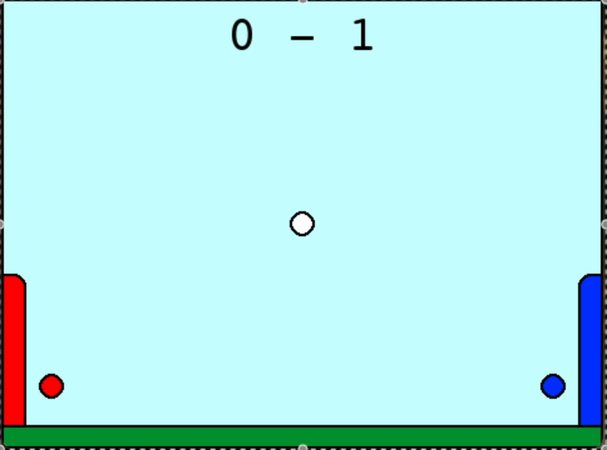
Pen Football
What is it?
Online 2-player game like soccer
Aim: shoot the ball into the goal
Controls: WASD/arrow keys
Left/Right: Accelerate horizontally
Up: One-time reset of vertical velocity, allows double jumps

Slide 3
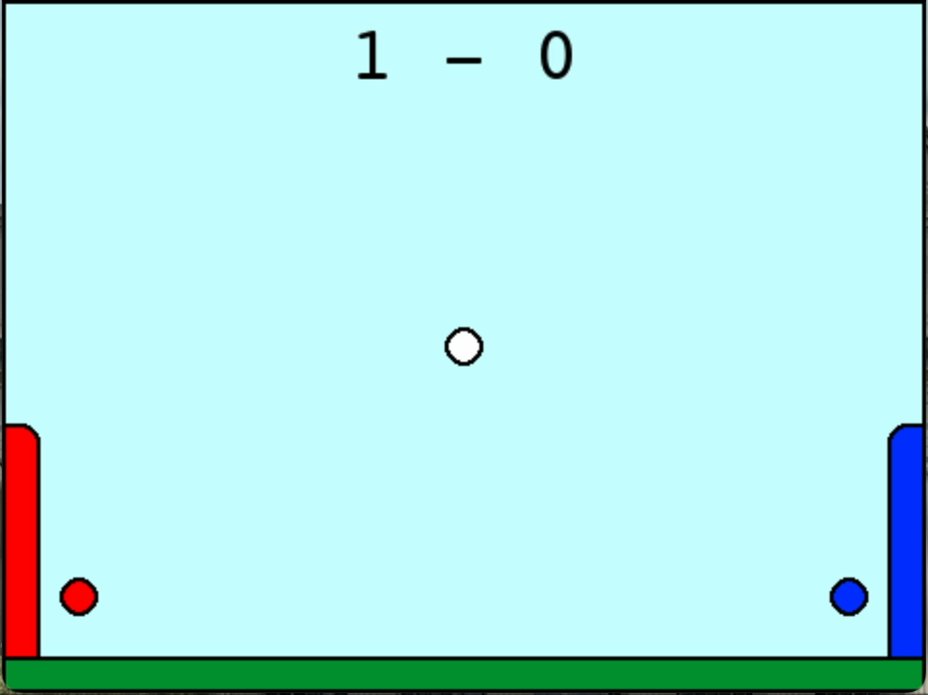
Challenges
Control:
Techniques like shooting, dribbling only by controlling acceleration
Strategy:
Aggressiveness, aiming
Planning:
Positioning, anticipation (for blocking)

Slide 4
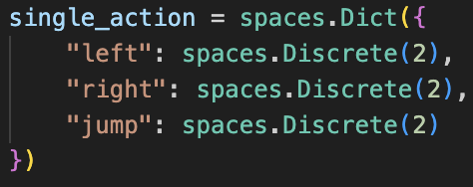
Solution Setup
Two-player game implemented in pygame
Game-playing interface for model implemented in gymnasium.Env
Both MultiAgent mode and drill mode (for curriculum learning)
League training:
Model plays previous versions of itself - checkpoints saved every fixed number of epochs
Models implemented in pytorch
Takes in game observations red/ball/blue x/y-position/velocity
Outputs 3 logits for each of the left/right/up keys
Rationale: model should be allowed all possible combinations of actions as humans
→ Challenge: Coherence!

Slide 5
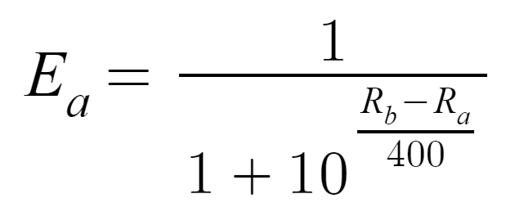
Evaluation Methodology
ELO ratings (similar to chess)
Small group of diverse models as baseline
New models incrementally added into pool
Ensures stability in rating through enough randomization
Eventual range of ratings was 1500-2400

Slide 6
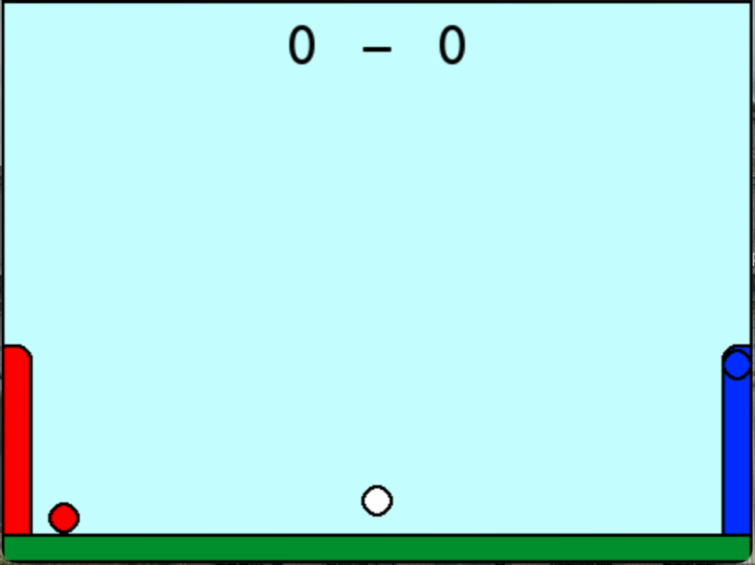
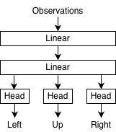
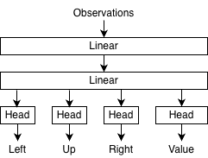
REINFORCE vs PPO
Example of model trained by REINFORCE (Blue) vs human (Red)
Policy Network (REINFORCE)
Policy + Value Network (PPO)

Slide 7
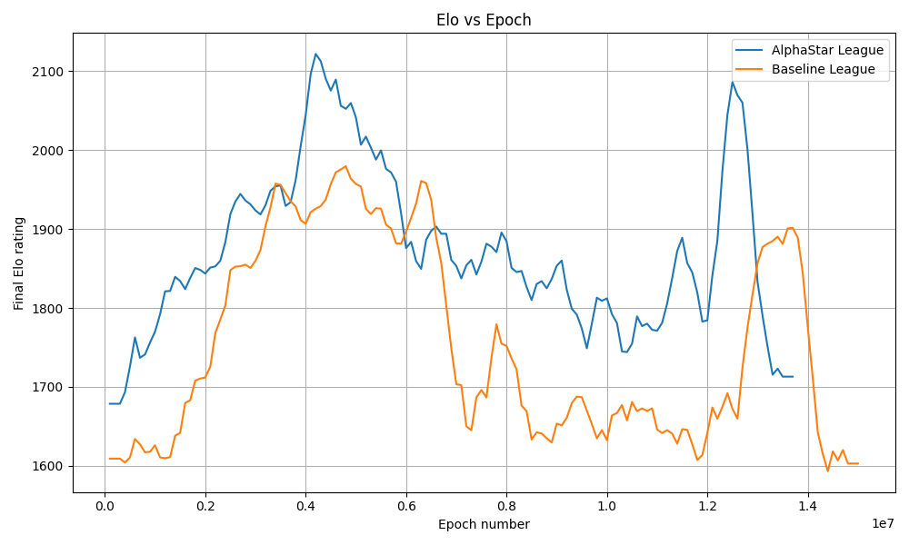
Naive League vs AlphaStar League
In the initial league system, the model saves checkpoints and chooses an arbitrary one from recent ones to play against.
In the AlphaStar League system, the model keeps track of it’s win history against each opponent (same system as TStarBox-X used for AlphaStar)
This allows it to prioritize playing against opponents that it has struggled against recently
Volatility (Delta Variances)
AlphaStar League – 5983.12
Baseline League – 10617.98

Slide 8
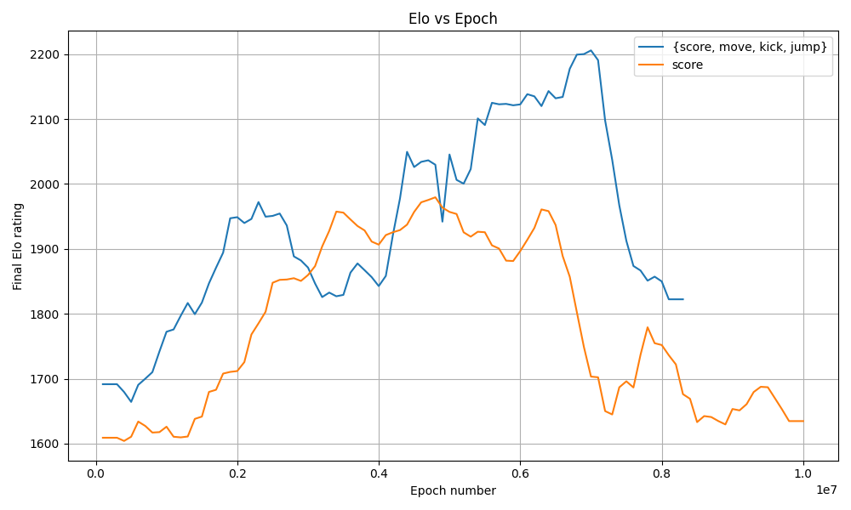
Reward Shaping (score vs {score, move, kick, jump})
By shaping the rewards to be
more specific, performance
improves!
Scoring, kicking, moving, and
jumping are all weighted
appropriately
Delta variances roughly similar- 5981.64, 6198.21

Slide 9

Scaling Laws
Anything beyond two hidden
layers between observations
and logits makes training collapse!

Slide 10
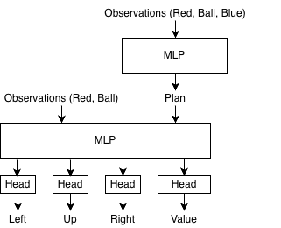
Model Architecture (MLP vs CurriculumMLP)

Slide 11
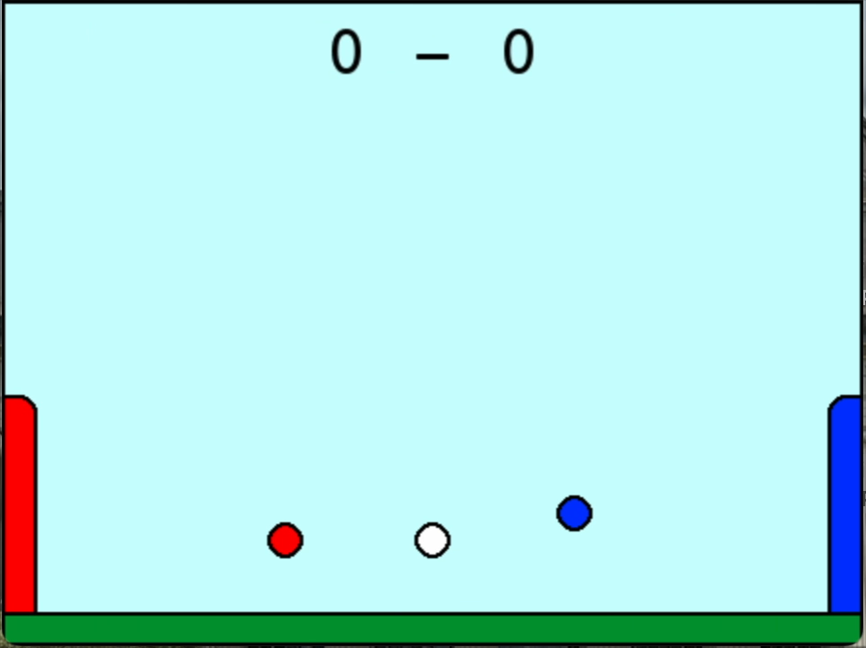
Enjoy a game from our best models!

Slide 12
Play here!

Slide 13

Thank youu!

